Slide 1
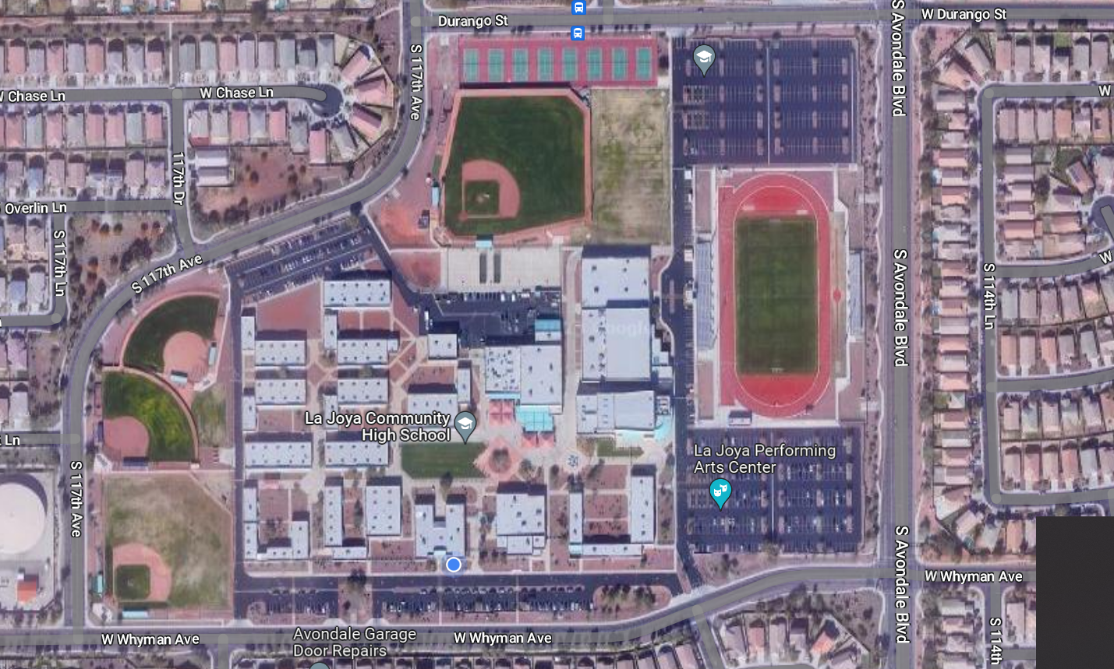
STUDENT DROP OFF
ENTER/EXIT ONLY
NO STUDENT DROP OFF IN BLUE X AREA
Student Drop Off Only
Drive Around
NO STUDENT DROP OFF
Staff Parking Lot ONLY
Student parking
Staff & Special Service Parkig
ONLY
Student Parking Entrance
Administration/Office and Guest Parking
ENTRANCE ONLY
NO STUDENT DROP OFF IN BLUE X AREA
School Bus Entrance
ONLY
Staff &
Special Service Entrance ONLY
Special Service Bus Pick Up & Drop Off ONLY
Student Drop Off (ONLY)
Along RED

